Slide 1
Database Security
Based on Chapter 6
Security in Computing
Pfleeger and Pfleeger

Slide 2
What is a database?
Database = collection of data + set of rules that specify certain relationships among the data.
Data is stored in one or more files
The database file consists of records, which in turn consists of fields or elements.
Data can be organised in tables. All columns are given names, which are the attributes of the database.
A relation is a set of columns

Slide 3
Components of Databases
Record – contain one related group of data
Each record contains fields or elements
The logical structure of a database is called a schema
A particular user may have access to only part of the database, called a subschema
Adams | 212 Market St. | Columbus | OH | 43210
Benchly | 501 Union St. | Chicago | IL | 60603
Carter | 411 Elm St. | Columbus | OH | 43210

Slide 4
Queries
Users interact with database managers through commands to the DBMS that retrieve, modify, add, or delete fields and records of the database.
A command is called a query.
For example,
SELECT NAME = 'ADAMS'
8

Slide 5
Advantage of Using Databases
A database is a single collection of data, stored and maintained at one central location, to which many people may have access as needed
The users are unaware of the physical arrangements; the unified logical arrangement is all they see

Slide 6
Advantage of Using Databases …
Shared access – multiple users use one common, centralized set of data
Minimal redundancy – individual users do not have to collect and maintain their own sets of data
Data consistency – change to a data value affects all users of the data value
Data integrity – data values are protected against accidental or malicious undesirable changes
Controlled access – only authorized users are allowed to view or to modify data value

Slide 7
Security Requirements
Physical database integrity – data of a database immune to physical problems
Logical database integrity – structure of the database is preserved. A modification to a field doesn’t affect another
Element integrity – data present in each element is accurate

Slide 8
Security Requirements
Auditability – it is possible to track who or what has accessed / modified the elements
Access control – authorized users only
User authentication – for audit trail/for permission to access, every user is positively identified
Availability – users can access database and all authorized data

Slide 9
Integrity of the Database
User must be able to trust the accuracy of data values
DBA must ensure that the updates are made only by authorized individuals
Data must be protected from corruption
By illegal program action
By an outside force like fire
Damage could be to whole database or individual data items

Slide 10
Integrity of the Database
Integrity of the database as a whole is the responsibility of the DBMS, the OS, and the computing system manager
Regularly take backup of all files (db)
Periodic backups can adequately control the failure
Must be able to reconstruct the database at the point of a failure
Restore database to a stable point
DBMS must maintain a log of transactions
Take a backup copy and reprocess all the transactions from the log

Slide 11
Element Integrity
Integrity of database elements is the correctness or accuracy of elements
How to catch errors or take corrective action
Field checks - activities that test for appropriate values in a position
Access control
Data files may contain data from several sources and redundant data may be stored in several places
Maintain a change log – list every change made to the database
It contains both original and modified values.
Using this log, a database administrator can undo any changes that were made in error.

Slide 12
Auditability & Access Control
Desirable to generate an audit record of all access to the database (reads/writes)
Helps to maintain database’s integrity
Audit trail can tell that which user has been given which data (through sequential accesses)
Audit trails should include accesses at record, field and element levels
Pass-through problem – accessing a record or element without transferring the data received to the user (no reads/writes)
Databases separated logically by user access privileges

Slide 13
Other Security Requirements
User Authentication
Confidentiality
Availability

Slide 14
Reliability and Integrity
Database integrity (damage)
Element integrity (unauthorized modification)
Element accuracy (correct values only)
Some protection from OS
File access (standard access control of OS)
Data integrity checks (on normal read/write for I/O)

Slide 15
Two-Phase Update
Failure of computing system in middle of modifying data
If the data item to be modified was a long field, half of the field might show the new value, while the other half would contain the old.
Intent Phase – gather resources needed for update; write commit flag to the database
Update Phase – make permanent changes

Slide 16
2P Update Example
The stockroom checks the database to determine that 50 boxes of paper clips are on hand. If not, the requisition is rejected and the transaction is finished.
If enough paper clips are in stock, the stockroom deducts 50 from the inventory figure in the database (107 - 50 = 57).
The stockroom charges accounting's supplies budget (also in the database) for 50 boxes of paper clips.

Slide 17
2P Update Example
The stockroom checks its remaining quantity on hand (57) to determine whether the remaining quantity is below the reorder point.
Because it is, a notice to order more paper clips is generated, and the item is flagged as "on order" in the database.
A delivery order is prepared, enabling 50 boxes of paper clips to be sent to accounting.
All five of these steps must be completed in the order listed for the database to be accurate and for the transaction to be processed correctly.

Slide 18
2P Update Example
When a two-phase commit is used, shadow values are maintained for key data points.
A shadow data value is computed and stored locally during the intent phase, and it is copied to the actual database during the commit phase.

Slide 19
2P Update Example
Intent:
Check the value of COMMIT-FLAG in the database. If it is set, this phase cannot be performed. Halt or loop, checking COMMIT-FLAG until it is not set.
Compare number of boxes of paper clips on hand to number requisitioned; if more are requisitioned than are on hand, halt.
Compute TCLIPS = ONHAND - REQUISITION.
Obtain BUDGET, the current supplies budget remaining for accounting department.
Compute TBUDGET = BUDGET - COST, where COST is the cost of 50 boxes of clips.
Check whether TCLIPS is below reorder point; if so, set TREORDER = TRUE; else set TREORDER = FALSE

Slide 20
2P Update Example
Commit:
Set COMMIT-FLAG in database.
Copy TCLIPS to CLIPS in database.
Copy TBUDGET to BUDGET in database.
Copy TREORDER to REORDER in database.
Prepare notice to deliver paper clips to accounting department. Indicate transaction completed in log.
Unset COMMIT-FLAG.

Slide 21
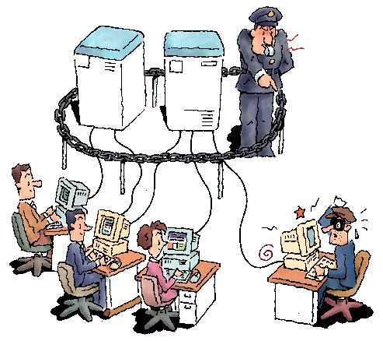
Authorization
Sudarshan - IITB
Different authorizations for different users
Accounts clerk vs.
Accounts manager vs.
End users

Slide 22
Database/Application Security
Sudarshan - IITB
Ensure that only authenticated users can access the system
And can access (read/update) only data/interfaces that they are authorized to access

Slide 23
Limitations of SQL Authorization
Sudarshan - IITB
SQL does not support authorization at a tuple level
E.g. we cannot restrict students to see only (the tuples storing) their own grades
Web applications are dominant users of databases
Application end users don't have database user ids, they are all mapped to the same database user id
Database access control provides only a very coarse application-level access control

Slide 24
Redundancy / Internal Consistency
Error detection / Correction codes (parity bits, Hamming codes, CRCs)
Shadow fields - Entire attributes or entire records can be duplicated in a database. If the data are irreproducible, this second copy can provide an immediate replacement if an error is detected.
Log of user accesses and changes
Recovery
In addition to these error correction processes, a DBMS can maintain a log of user accesses, particularly changes.
In the event of a failure, the database is reloaded from a backup copy and all later changes are then applied from the audit log.

Slide 25
SQL Security Model
SQL security model implements DAC based on
users: users of database - user identity checked during login process;
actions: including SELECT, UPDATE, DELETE and INSERT;
objects: tables (base relations), views, and columns (attributes) of tables and views
Users can protect objects they own
when object created, a user is designated as ‘owner’ of object
owner may grant access to others
users other than owner have to be granted privileges to access object

Slide 26
Identity Theft
Sudarshan - IITB
Pretend to be someone else and get credit cards/loans in their name
Identification based on “private” information that is not hard to obtain online
More lucrative than blue-collar crime,
harder to catch criminals
Hurts victims even more than regular theft
Onus goes on innocent people to prove they didn’t get loans or make credit card payment
Credit history gets spoilt, making it harder to get future loans
And you may have been robbed without ever knowing about it.
Increasing risk in India
Aadhaar / PAN numbers, names available online

Slide 27
What me worry?
Sudarshan - IITB
“Bad things only happen to other people.”??
SQL/Slammer
Attacked SQLServer, brought networks down all over the world
Luckily no data lost/stolen
Careless coding exposed database password to outside world
Most Web applications vulnerable to SQL injection attacks

Slide 28
Database Encryption
Sudarshan - IITB
e.g. What if a laptop/disk/USB key with critical data is lost?
Partial solution: encrypt the database at storage level, transparent to application
Whole database/file/relation
Unit of encryption: page
Column encryption
Main issue: key management
e.g. user provides decryption key (password) when database is started up
Supported by many database systems
Standard practice now to encrypt credit card information, and other sensitive information

Slide 29
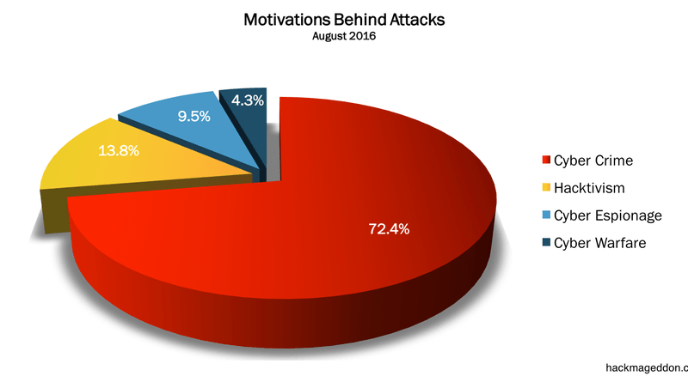
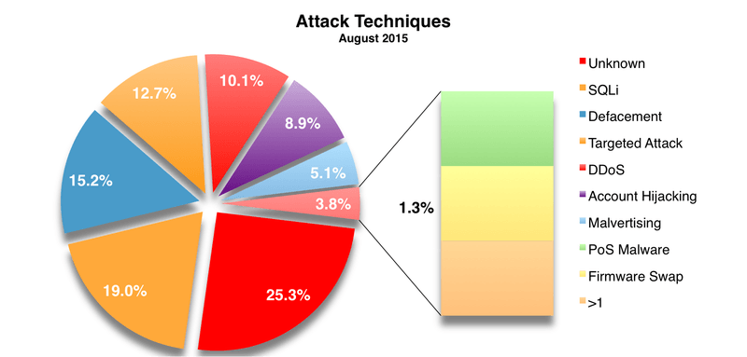
Attack Techniques

Slide 30
SQL Injection
Occurs when an attacker is able to insert a series of SQL statements into a query by manipulating data input into an application
SELECT (id, firstname, surname) FROM authors WHERE firstname = ‘deepak’ AND surname = ‘sharma’;
firstname and surname fields are gathered from user-supplied input

Slide 31
SQL Injection …
SELECT (id, firstname, surname) FROM authors WHERE firstname = ‘de’epak’ AND surname = ‘sharma’;
Results into error
Incorrect syntax near ‘epak’

Slide 32
SQL Injection …
firstname: de’; DROP TABLE authors --
surname:

Slide 33
SQL Injection
App sends form to user.
Attacker submits form with SQL exploit data.
Application builds string with exploit data.
Application sends SQL query to DB.
DB executes query, including exploit, sends data back to application.
Application returns data to user.
Attacker
Form
User
Pass
‘ or 1=1--
Firewall
DB Server
Web Server

Slide 34
SQL Injection in PHP
$link=mysql_connect($DB_HOST, $DB_USERNAME, $DB_PASSWORD) or die ("Couldn't connect: " . mysql_error());
mysql_select_db($DB_DATABASE);
$query = "select count(*) from users where username = '$username' and password = '$password‘ ";
$result = mysql_query($query);

Slide 35
SQL Injection Attack #1
Unauthorized Access Attempt:
password = ’ or 1=1 --
SQL statement becomes:
select count(*) from users where username = ‘user’ and password = ‘’ or 1=1 --
Checks if password is empty OR 1=1, which is always true, permitting access.

Slide 36
SQL Injection Attack #2
Database Modification Attack:
password = foo’; delete from table users
where username like ‘%
DB executes two SQL statements:
select count(*) from users where username = ‘user’ and password = ‘foo’
delete from table users where username like ‘%’
Principle of Least Privilege likely violated as web server user needs privileges to do all operators permitted on users, including deleting them.

Slide 37

Webcomic
School: Hi, this is your son's school. We're having some computer trouble.
Mom: Oh, dear -- Did he break something?
School: In a way. Did you really name your son Robert'); DROP TABLE Students;--?
Mom: Oh. Yes. Little Bobby Tables we call him.
School: Well, we've lost this year's student records. I hope you're happy.
Mom: And I hope you've learned to sanitize your database inputs.
Reference
1. www.bobby-tables.com
2. From the webcomic xkcd

Slide 38
Other injection possibilities
Using SQL injections, attackers can:
Add new data to the database
Could be embarrassing
Perform an INSERT in the injected SQL
Modify data currently in the database
What ? Commercial / Business Websites
Perform an UPDATE in the injected SQL
Gain access to other user’s system capabilities by obtaining their password

Slide 39
Best defense
If possible, use bound variables with prepared statements
Many libraries allow you to bind inputs to variables inside a SQL statement
PERL
See http://bobby-tables.com for example code in many languages

Slide 40
How does this prevent an attack?
SQL statement you pass to prepare is parsed and compiled by the database server.
By specifying parameters (either a ? or a named parameter like :name) you tell the database engine what to filter on.
Then when you call execute the prepared statement is combined with the parameter values you specify.

Slide 41
More Defenses
Check syntax of input for validity
Many classes of input have fixed languages
Email addresses, dates, part numbers, etc.
Verify that the input is a valid string in the language
Some languages allow problematic characters (e.g., ‘*’in email); may decide to not allow these
Exclude quotes and semicolons
Alternatives:
use stored procedures
use a function that removes special characters (such as quotes) from strings
Not always possible: consider the name Bill O’Reilly
Want to allow the use of single quotes in names
Have length limits on input
Many SQL injection attacks depend on entering long strings

Slide 42
More Defenses
Scan query string for undesirable word combinations that indicate SQL statements
INSERT, DROP, etc.
If present then check against SQL syntax to see if they represent a statement or valid user input
Limit database permissions and segregate users
Connect to database as a user that only has read permissions
Never connect as a database administrator in your web application

Slide 43
And Yet More Defenses
Configure database error reporting
Default error reporting often gives away information that is valuable for attackers (table name, field name, etc.)
Configure so that this information is never exposed to a user

Slide 44
SQL Security Model
Components of privilege are
grantor, grantee, object, action, grantable
privileges managed using GRANT and REVOKE operations
the right to grant privileges can be granted
Issues with privilege management
each grant of privileges is to an individual or to “Public”
makes security administration in large organizations difficult
individual with multiple roles may have too many privileges for one of the roles
Role based privileges??

Slide 45
SQL Security Model
Authentication & identification mechanisms
CONNECT <user> USING<password>
DBMS may chose OS authentication
or its own authentication mechanism
Kerberos
PAM

Slide 46
Active Directory
On a computer network, a directory is both a data store used for storing and organizing information about objects on a computer network and the directory service used for locating and retrieving the information about those network objects from the data store.
https://technet.microsoft.com/en-us/library/bb463152.aspx

Slide 47
Active Directory
Active Directory was introduced with Microsoft Windows
Two core services that Active Directory provides are:
Directory services. Stores user, group, computer, and much other information about a network.
Security services. Enables clients to retrieve information from its data store in order to provide services such as authentication and authorization.
Uses a hierarchical structure—including forests, sites, domains, as well as the user, group, and computer accounts —to hold information about network objects.

Slide 48
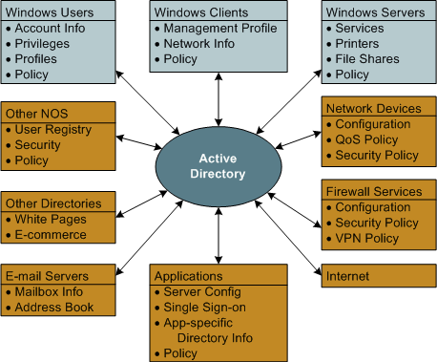
Active Directory's central role

Slide 49
Kerberos and LDAP
Most implementations of UNIX and the Active Directory service in Windows Server can use Kerberos and LDAP to provide secure, centralized authentication for identified users and to determine if an authenticated user is authorized to access a specific network resource.
Both Kerberos and LDAP are platform-independent TCP/IP-based IETF standards, and both are client/server protocols.

Slide 50
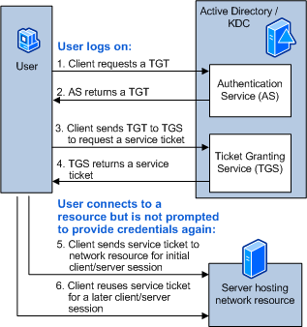
Interactive logon followed by authenticating to a network resource

Slide 51
SQL Security Model
Access control through views
Many security policies better expressed by granting privileges to views derived from base relations
Views into tables provide user access flexibility, because any designated DB user or collection of DB users can be provided with customized access to a view
Also, table T can be private, but a view VT on T can be made SELECTed by user(s)
Example
CREATE VIEW AVSAL(DEPT, AVG)
AS SELECT DEPT, AVG(SALARY)
FROM EMP GROUP BY DEPT
Access can be granted to this view for every dept manager
Example
CREATE VIEW MYACCOUNT AS
SELECT * FROM Account
WHERE Customer = current_user()
View containing account information for current user

Slide 52
Concurrency/Consistency
Access by two users sharing the same database must be constrained
Monitors – check entered values to ensure consistency with rest of DB
Range Comparisons
State Constraints – describes condition of database (unique employee #)
Transition Constraints – conditions before changes are applied to DB

Slide 53
Monitors
Unit of a DBMS responsible for the structural integrity of the database
A monitor can check values entered to ensure their consistency with the rest of the database or with characteristic of a particular field

Slide 54
Monitors - Types
Range Comparisons: Tests each new value to ensure that the value is within an acceptable range, otherwise reject
Ensure internal consistency of a database (student, employee)
Control data allowed in the database
Test existing values for reasonableness
Filters or patterns are general data form checks
If you suspect that the data in a database has been corrupted, a range check of all records could identify those having suspicious values

Slide 55
State/transition Constraints
If constraints are not met, some value of the database is in error
Example
during Commit phase, COMMIT-FLAG is set and cleared at the end of the transaction
Uniqueness of database entry is violated
Transition Constraints describe conditions necessary before changes can be applied

Slide 56
Sensitive Data
Data that should not be made public
Determining which data items and fields are sensitive depends both on the individual database and underlying meaning of the data
Nothing is sensitive
Everything is sensitive
Publicly available data
Military data
Security concerns not only the data elements but also their context and meaning

Slide 57
Sensitive Data
What if some but not all of the elements of a DB are sensitive?
Varying degree of sensitivity
Inherently sensitive
From a sensitive source
Declared sensitive
Part of a sensitive attribute or record
Sensitive in relation to previously disclosed information
Want different kinds of access restrictions to access by different users

Slide 58
Access Decisions
Database Administrator is a person who decides what data should be in the database and who should have access to it
Decisions of database administrator are based on an access policy
Need an access policy (programmed into DBMS for its implementation)
DBMS may consider several factors when deciding whether to permit an access

Slide 59
Types of Disclosures (sometimes without direct access)
Exact Data - most serious disclosure is exact value of sensitive data item
Use may request general data from sensitive data
Bounds
Exposure due to release of bounds (lower and upper bound on a sensitive value
User may not have requested sometimes (a fault)

Slide 60
Types of Disclosures …
Negative Results
Deduce and conclude from a specially worded query
revealing that the data item does not have a specific value can be compromising, in particular that the value is not 0.
Existence of Data
the existence of a data may be sensitive, e.g. a criminal record regardless of actual value
Probable Values
probable values: it might be possible to determine the probability that an element has a certain value
Does the president of USA is registered in the Tory party
A successful security strategy must protect from both direct/indirect disclosure

Slide 61
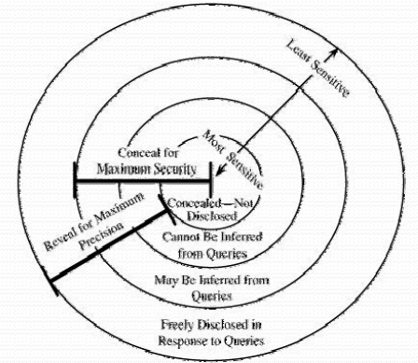
Security vs. Precision
Aim to protect all sensitive data while revealing as much nonsensitive data as possible
Want to maintain perfect confidentiality with maximum precision

Slide 62
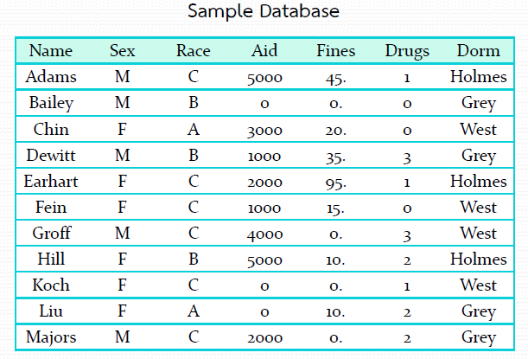
Inference
It’s a way to infer / derive sensitive data from non-sensitive data

Slide 63
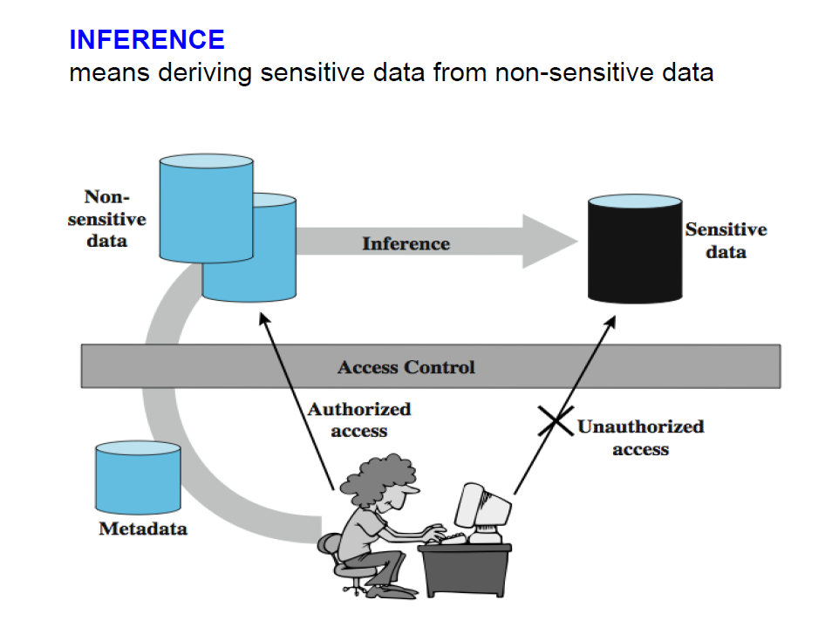
Inference

Slide 64
Direct Attack
A user tries to determine values of sensitive fields by seeking them directly with queries that yield few records
A sensitive query might be
List NAME where SEX=M ∧ DRUGS=1
This query discloses that for record ADAMS, DRUGS=1. However, it is an obvious attack because it selects people for whom DRUGS=1, and the DBMS might reject the query because it selects records for a specific value of the sensitive attribute DRUGS

Slide 65
Direct Attack
Another query is
List NAME where (SEX=M ∧ DRUGS=1) ∨ (SEX≠M ∧ SEX ≠ F) ∨ (DORM=AYRES)
This query still retrieves only one record, revealing a name that corresponds to the sensitive DRUG value. The DBMS needs to know that SEX has only two possible values so that the second clause will select no records.
DBMS would also need to know that no records exist with DORM=AYRES, even though AYRES might in fact be an acceptable value for DORM

Slide 66
Direct Attack contd.
Do not reveal results when a small number of people make up a large proportion of a category.
The rule of "n items over k percent" means that data should be withheld if n items represent over k percent of the result reported.

Slide 67
Statistical Databases
Provide data of a statistical nature e.g. counts, averages
Two types:
pure statistical database
ordinary database with statistical access
some users have normal access, others statistical
Access control objective is to allow statistical use without revealing individual entries
Some organizations would reveal only neutral statistics such as sum, count, and mean

Slide 68
Statistical Database Security
Statistical Database Security use a characteristic formula C
A logical formula over the values of attributes
e.g. (Sex=Male) AND ((Major=CS) OR (Major=EE))
A statistical query is a query that produces a value calculated over a query set

Slide 69
Indirect Attack
It seeks to infer a final result based on one or more intermediate statistical results
Requires work outside the database itself to obtain / infer some value

Slide 70
Indirect Attack
Sum – An attack by sum tries to infer a value from a reported sum.
Count – The count can be combined with the sum to produce some even more revealing results.
Mean – The arithmetic mean (average) allows exact disclosure if the attacker can manipulate the subject population.
Median – With more complicated process, we can determine an individual value from medians

Slide 71
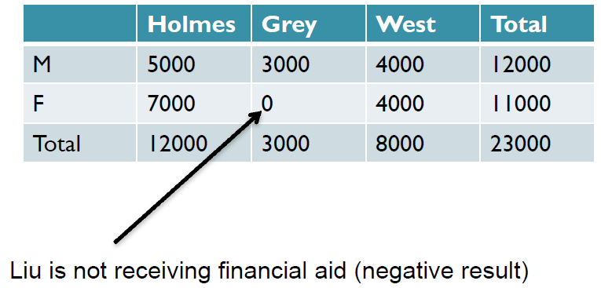
Indirect Attack
Median
Show STUDENT-AID WHERE SEX=F ^ DORM=Grey
Count
Show Count, STUDENT-AID WHERE SEX=M ^ DORM=Holmes
List NAME where (SEX=M ^ DORM=Holmes)

Slide 72
Inference via Queries based on Sensitive Data
Sensitive information is used in selection condition but not returned to the user
Protection: apply query of database views at different security levels

Slide 73
Prevention
Protection from small/large query set attack:
query-set-size control
e.g. a query q(C) in a DB describing 100 individuals is permitted only if
100 – 5 = 95 ≥ |C| ≥ 5
that is if it can’t give statistics on a group smaller than 5 individuals
(Note: If it gives statistics on C for e.g., 96 people, it gives statistics on not-C for 4 people.)

Slide 74
Other Indirect Attacks - Tracker Attacks
A tracker attack can fool the database manager into locating the desired data by using additional queries that produce small results.
The tracker adds additional records to be retrieved for two different queries; the two sets of records cancel each other out, leaving only the statistic or data desired.
The approach is to use intelligent padding of two queries.
In other words, instead of trying to identify a unique value, we request n - 1 other values (where there are n values in the database). Given n and n - 1, we can easily compute the desired single element

Slide 75
Tracker Attack 1
Query q(C) is disallowed
C = C1 and C2
T = C1 and ~C2
T - Tracker
C
C2
C1
Attacker runs instead 2 queries: q(C1) and q(T)
where q(C) = q(C1) – q(T)
=> infers q(C) from q(C1) and q(T)

Slide 76
Tracker Attack 2
Query q(C and D)
is disallowed
C
Tracker
C = C1 and C2
T = C1 and ~C2
C2
C1
C and D
D
Attacker runs instead 2 queries: q(T or C and D) and q(T)
where q(C and D) = q(T or C and D) – q(T)
=> infers q(C and D) from q(T or C and D) and q(T)

Slide 77
Tracker Attacks
For instance, suppose we wish to know how many female Caucasians live in Holmes Hall.
A query posed might be
count((SEX=F) ∧ (RACE=C) ∧ (DORM=Holmes))
The database management system might consult the database, find that the answer is 1, and refuse to answer that query because one record dominates the result of the query

Slide 78
Tracker Attacks …
The query
q=count((SEX=F) ∧ (RACE=C) ∧ (DORM=Holmes))
is of the form
q = count(a ∧ b ∧ c)
This query is same as:
q = count(a ∧ b ∧ c) = count(a) - count(a ∧ ¬(b ∧ c))
Thus, the original query is equivalent to
count (SEX=F)
minus
count ((SEX=F) ∧ ((RACE ≠ C) ∨ (DORM ≠ Holmes)))

Slide 79
Conclusion on Inference Problem
Suppress obviously sensitive information
Track what the user knows
Disguise the data

Slide 80
Controls for statistical inference attacks
Limited Response Suppression
The n-item, k-percent rule eliminates certain low-frequency elements
It is not sufficient to delete them, however, if their values can also be inferred
Query restriction (suppression) - reject query without response (data withheld)
Combining results: present values in ranges
Combining rows or columns
Rounding

Slide 81
Controls for statistical inference attacks
Random sample
compute the result on a random sample of the database
Random data perturbation (data or output) (concealing) - provide an inexact answer to the query / add an error term
Query analysis, i.e. track what the user knows
keeping track on previous queries (query history)
maintain a record for each user of earlier queries
this method is extremely costly

Slide 82
Perturbation
Add noise / error to statistics generated from data
will result in differences in statistics
Data perturbation techniques
data swapping
generate statistics from underlying probability distribution of attributes
Output perturbation techniques
random-sample query (based on a subset)
statistic adjustment of result (random or not)
Perturbation techniques may result in loss of accuracy in results

Slide 83
Aggregation
Building sensitive results from less sensitive inputs
Aggregation problem exists when the aggregate of two or more data items is classified at a level higher than the classification of the individual items
the data items multiple instances of same entity
Building sensitive results from less sensitive inputs
Notes:
Aggregation Examples
The traditional example of (cardinal) aggregation is the intelligence agency telephone book:
individual entries are unclassified but the total book is classified [Lunt 89]. The challenge with this
example is understanding what information the agency is trying to protect with the policy. Is it the
name and number of staff personnel (and therefore capability) of each (or some) organizational
element? The total staffing size of the agency? Identification of special employees? Special skills?
A clear understanding of what information needs to be protected must precede a cardinal
aggregation policy

Slide 84
Aggregation
Data mining – process of sifting through multiple databases and correlating multiple data elements to find useful information
Data association: A sub-problem of aggregation
data association – sensitive associations between instances of two or more distinct data items
(cardinal) aggregation - associations among multiple instances of the same entity
Addressing the aggregation problem is difficult
it can take place outside the system
Notes:
Data Association Examples
A traditional example of intra-entity data association involves salary: the identity of an employee
and the actual number that represents the employee’s salary may both be unclassified, but the
association between a particular employee and the employee’s salary is considered sensitive. This
is an instance of intra-entity data association as defined above: employee name (or other
identifying attributes such as employee number) and salary are both attributes of the employee
entity.
An example of inter-entity data association is the following: the identity of commercial companies
and government agencies are unclassified, but the association of a particular company as the
contractor for a particular government agency may be considered classified. In this case, the data
association is between two entities, commercial company and government agency.

Slide 85
Inference vs. Aggregation
They are similar but different
Inference: sensitive data deduced from non sensitive data
relatively easier problem
protection by means of control over query , data and other ways
Aggregation: multiple instances of entity result in sensitive data
difficult problem
protection requires the DBMS to track what results each user had already received
Notes:
Data Association Examples
A traditional example of intra-entity data association involves salary: the identity of an employee
and the actual number that represents the employee’s salary may both be unclassified, but the
association between a particular employee and the employee’s salary is considered sensitive. This
is an instance of intra-entity data association as defined above: employee name (or other
identifying attributes such as employee number) and salary are both attributes of the employee
entity.
An example of inter-entity data association is the following: the identity of commercial companies
and government agencies are unclassified, but the association of a particular company as the
contractor for a particular government agency may be considered classified. In this case, the data
association is between two entities, commercial company and government agency.

